Slide 1

CSG2344 Project Methods and Professionalism
Project Management – Scope
Are user expectations the same thing as a system specification?
ECU Copyright 2015 – CSG2344 School of Computer and Security Science

Slide 2

Lecture Objectives
Project Planning (part of Integration Management)
Project Scope Planning
  Scope planning
  Scope definition
  WBS creation
  Scope verification
  Scope control
  - Scope creep
ECU Copyright 2015 – CSG 2344 School of Computer and Security Science

Slide 3
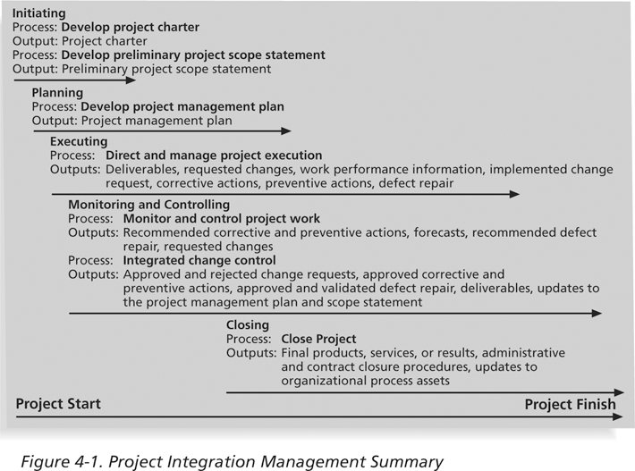
Project Processes Summary

Slide 4
Project Planning
Planning is often the most difficult and unappreciated process in project management.
Often, people do not want to take the time to plan well, but theory and practice show that good planning is crucial to good execution.
The main purpose of project planning is to guide project execution, so project plans must be realistic and useful.
ECU Copyright 2015 – CSG 2344 School of Computer and Security Science

Slide 5
Project Integration Management Planning Tasks
Project integration management involves coordinating all the project management knowledge areas throughout a project’s life span.
Main planning tasks include:
  Creating a team contract
  Developing the project management plan
ECU Copyright 2015 – CSG 2344 School of Computer and Security Science

Slide 6
Team Contracts
Team contracts help promote teamwork and clarify team communications.
- The process normally includes the core project team members working in small groups to prepare inputs for their team contract.
- The project manager should act as a coach, observing the different personalities of team members and seeing who works well together.
- Everyone involved in creating the team contract should sign it, and as new project team members are added, the project manager should review ground rules with them and have them read and sign the contract as well.
ECU Copyright 2015 – CSG 2344 School of Computer and Security Science

Slide 7

Topics Covered in a Team Contract
Code of conduct
Participation
Communication
Problem solving
Meeting guidelines
Information Sharing
Conflict resolution
ECU Copyright 2015 – CSG 2344 School of Computer and Security Science

Slide 8
Project Management Plans
A project management plan is a document used to coordinate all project planning documents and to help guide a project’s execution and control.
Plans created in the other knowledge areas are subsidiary parts of the overall project management plan and provide more detailed information about that knowledge area.
ECU Copyright 2015 – CSG 2344 School of Computer and Security Science

Slide 9
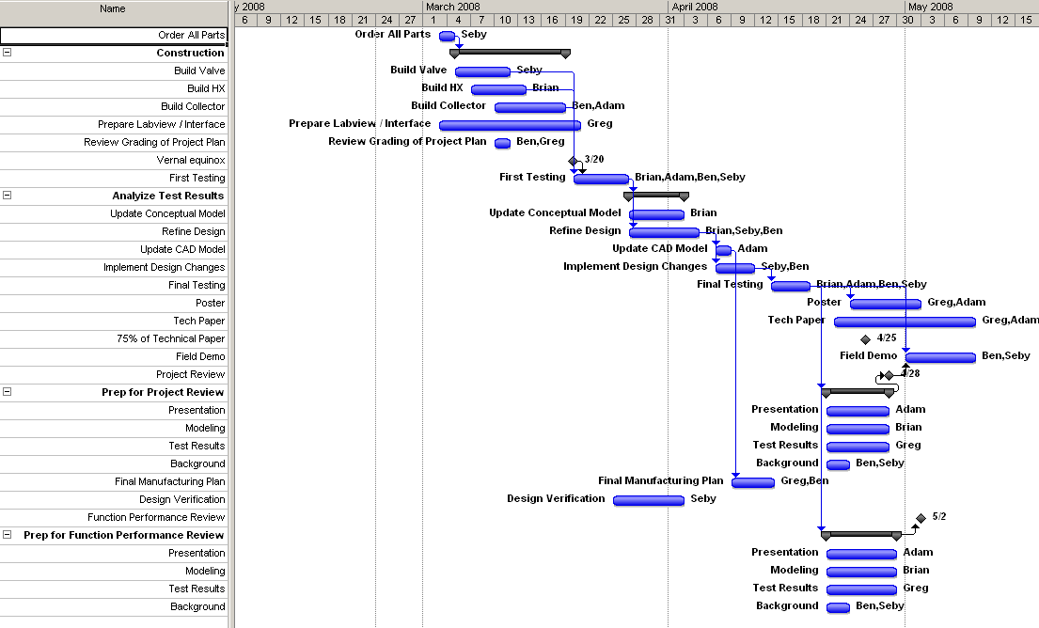
Project Management Plan
Introduction/overview of the project
Management and technical processes
Project Organisation
Work to be performed
Schedule information
Budget information
Other planning documents
  scope, time, cost, quality, risk, HR, communications, procurement
ECU Copyright 2015 – CSG 2344 School of Computer and Security Science

Slide 10
Project Scope Management
Project scope management is primarily concerned with defining and controlling what is and what is not included in the project
it ensures that the project team and stakeholders all have a clear understanding of the project deliverables and the processes used to produce them (Schwalbe, 2015).
ECU Copyright 2015 – CSG 2344 School of Computer and Security Science

Slide 11

Project Management –
Knowledge Areas
There are Ten Knowledge Management Areas.
(there used to only be 9)
Scope
Time
Cost
Quality
Communications
Risk
Human Resources
Procurement
Stakeholders
Integration
ECU Copyright 2015 – CSG 2344 School of Computer and Security Science

Slide 12
Project Scope Management Processes
- Scope planning
  documentation detailing how the other four processes will be created and defined.
- Scope definition
  develops a detailed project scope statement.
- Creating the WBS
  a deliverable-oriented breakdown of the total project scope.
- Scope verification
  formalised acceptance of the completed project deliverables.
- Scope control
  controlling changes to the project scope.
ECU Copyright 2015 – CSG 2344 School of Computer and Security Science

Slide 13

Scope Management Planning
The main documents produced are
  a scope management plan,
  scope statement,
  WBS, and
  WBS dictionary.
ECU Copyright 2015 – CSG 2344 School of Computer and Security Science

Slide 14
Scope Planning and the Scope Management Plan
A project’s size, complexity, importance, as well as other factors, affect how much effort is spent on scope planning.
A scope management plan describes how the team will
  prepare the scope statement,
  create the WBS,
  verify completion of the project deliverables,
  control requests for changes to the project scope.

Slide 15
The Scope Statement
The preliminary project scope statement should provide basic scope information, and subsequent scope statements should clarify and provide more specific information.
Work that is not included in the scope statement should not be done.
ECU Copyright 2015 – CSG 2344 School of Computer and Security Science

Slide 16
Work Breakdown Structure
WBS is used to plan in detail exactly what needs to be done by the project team through the defining and structuring of all of the deliverables needed to produce the project’s end products or manage the project
It is concerned with the what of the project, not the how, when, how much or who etc. It answers what is to be delivered
ECU Copyright 2015 – CSG 2344 School of Computer and Security Science

Slide 17
What is a WBS?
- Creating the WBS is the process of organising and subdividing the major project deliverables and project work into smaller manageable components of work, allowing for clear and comprehensive groupings of the deliverables which at their lowest level are called work packages
- “The WBS is a foundation document in project management because it provides the basis for planning and managing project schedules, costs, resources and changes”
- Often shown in two different forms:
  Chart form
  Tabular form
ECU Copyright 2015 – CSG 2344 School of Computer and Security Science

Slide 18
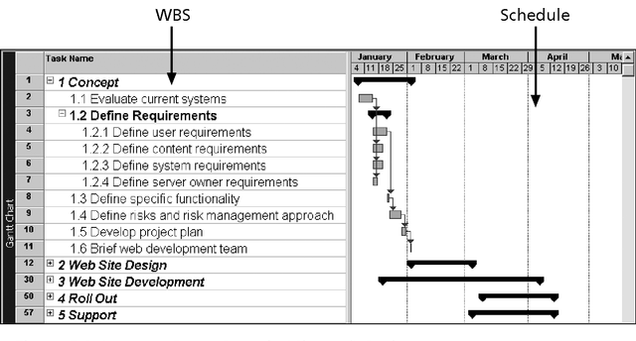
Intranet WBS and Gantt Chart in MS Project

Slide 19
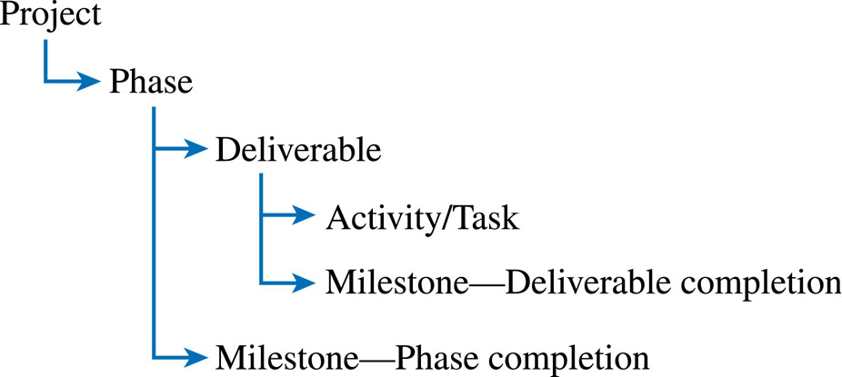
Work Breakdown
ECU Copyright 2015 – CSG 2344 School of Computer and Security Science

Slide 20
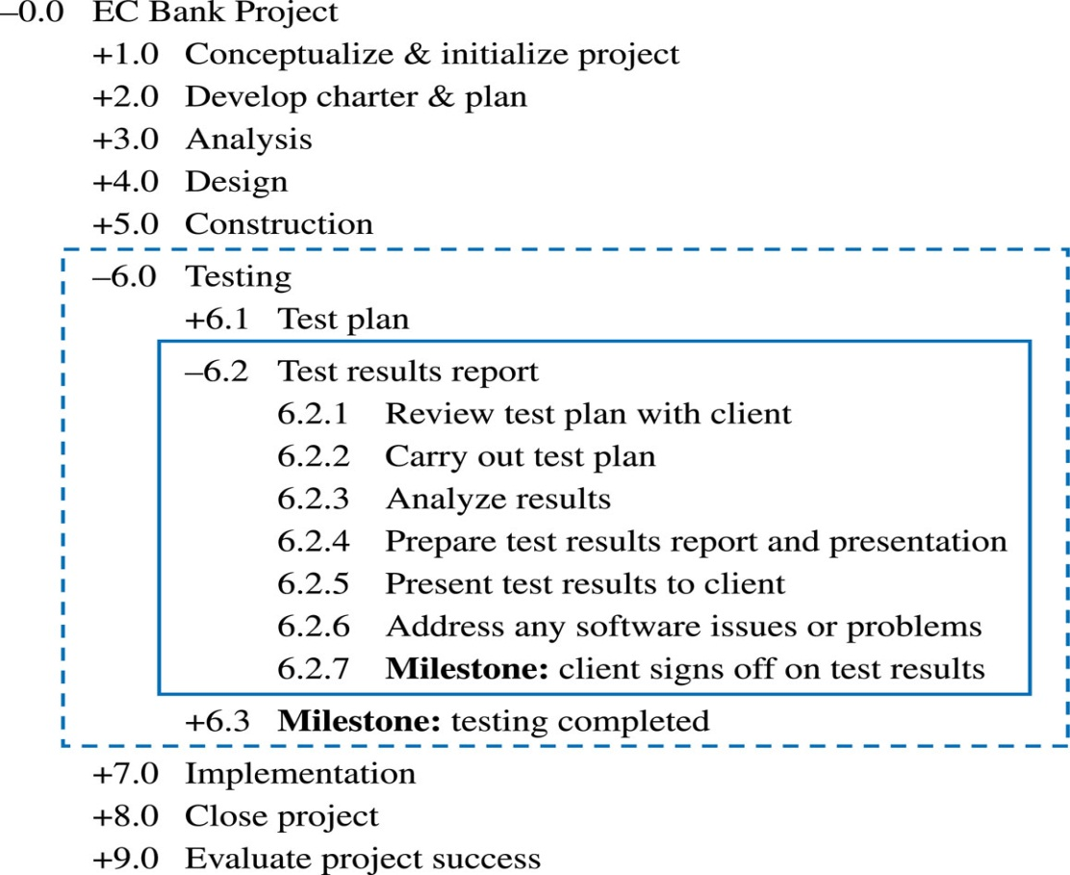
The WBS Should Follow the Work Package Concept
ECU Copyright 2015 – CSG 2344 School of Computer and Security Science

Slide 21
Work Packages
A work package is a task at the lowest level of the WBS.
It represents the level of work that the project manager monitors and controls.
Think of work packages in terms of accountability
  If a project has a relatively short time frame and requires weekly progress reports, a work package might represent work completed in one week or less.
  If a project has a very long time frame and requires quarterly progress reports, a work package might represent work completed in one month or more.
ECU Copyright 2015 – CSG 2344 School of Computer and Security Science

Slide 22

Deliverables and Milestones
Deliverables
  Tangible, verifiable work products
  Reports, presentations, prototypes, etc.
Milestones
  Significant events or achievements
  Acceptance of deliverables or phase completion
  Cruxes (proof of concepts)
  Quality control
  Keeps team focused
ECU Copyright 2015 – CSG 2344 School of Computer and Security Science

Slide 23
Inputs to WBS
- Organisational guidelines
  Policies and lessons learned reports from previous projects
- Preliminary scope statement
  From project initialisation
- Project Scope Management Plan
  details how the project scope will be defined and verified, and how the WBS will be created.
- Approved Change Requests
  during the lifetime of a project, changes will be requested, these can impact project scope, quality, costs and time. They need to go through the Integrated Change Control process before being added to the Project Scope Statement
ECU Copyright 2015 – CSG 2344 School of Computer and Security Science

Slide 24
Approaches to Developing WBSs
Analogy approach:
  Review WBSs of similar projects and tailor to your project.
Top-down approach:
  Start with the largest items of the project and break them down.
Bottom-up approach:
  Start with the specific tasks and roll them up.
Mind-mapping approach:
  Write tasks in a non-linear, branching format and then create the WBS structure.
ECU Copyright 2015 – CSG 2344 School of Computer and Security Science

Slide 25
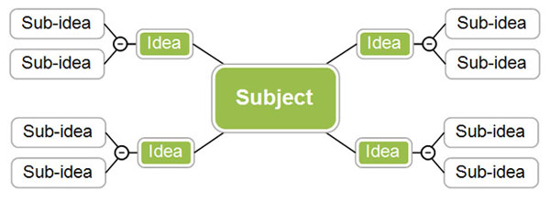
Sample Mind-Mapping Approach
ECU Copyright 2015 – CSG 2344 School of Computer and Security Science

Slide 26
Advice for Creating a WBS and WBS Dictionary
A unit of work should appear in only one place in the WBS.
The work content of a WBS item is the sum of the WBS items below it.
The WBS must be consistent with the way in which work is actually going to be performed; it should serve the project team first, and other purposes only if practical.
ECU Copyright 2015 – CSG 2344 School of Computer and Security Science

Slide 27
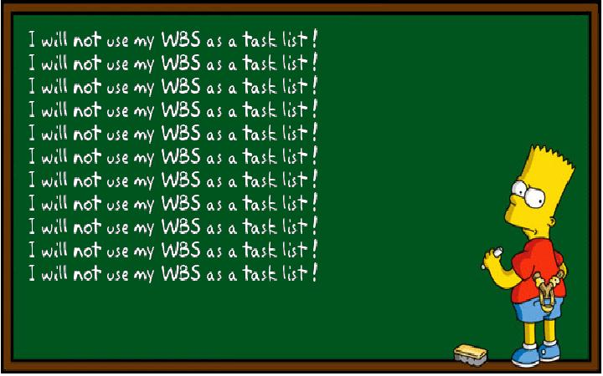
Advice for Creating a WBS and WBS Dictionary (cont’d)
Project team members should be involved in developing the WBS to ensure consistency and buy-in.
Each WBS item must be documented in a WBS dictionary to ensure accurate understanding of the scope of work that is included and not included in that item.
The WBS must be a flexible tool to accommodate inevitable changes while maintaining control of the work content based on the scope statement.
ECU Copyright 2015 – CSG 2344 School of Computer and Security Science

Slide 28
Creating a Good WBS
- It is difficult to create a good WBS.
- The project manager and the project team must decide as a group how to organize the work and how many levels to include in the WBS.
- It is often better to focus on getting the top levels of the WBS done well to avoid being distracted by too much detail.
- Many people confuse tasks on a WBS with specifications or think it must reflect a sequential list of steps.
ECU Copyright 2015 – CSG 2344 School of Computer and Security Science

Slide 29
Creating the WBS Dictionary
A WBS dictionary is a document that describes each WBS task in detail.
The format can vary based on project needs.
  It might be appropriate to have just a short paragraph describing each work package.
  For a more complex project, an entire page or more might be needed for the work-package descriptions.
  It might require describing the responsible person or organization, resource requirements, estimated costs, and other information.

Slide 30
Poor Scope causes failures
“Without a doubt, the most common reason that projects fail is because of poor scope definition. By that I mean that the expectations of the stakeholders, and especially the client or sponsor, are different than the expectations of the project team.
This is a most difficult problem, but it is critical to the success of the project that it is overcome.”
ECU Copyright 2015 – CSG 2344 School of Computer and Security Science

Slide 31
Problem … an example to consider
Once you have developed a WBS and WBS dictionary how do you know that meets all user expectations?
- Example for discussion. Your company has decided it wants to run in-house training for common training needs such as negotiation skills. Instead of sending staff on courses, this is to be available from an intranet. Benefits include just-in-time and significant reduction in costs (course fees, hotel bills etc).

Slide 32
Some answers
- Users might like to get away from the job for a few days and so be negative about on-line training.
- On-line training not good for developing interactive skills such as negotiation
- Management expects a reduction in cost but assumes that quality of experience will be the same. When it turns out that users don’t like it then they blame IT!
- An expectation is not the same as a set of deliverables. Expectations are met when a set of deliverables provide what management and users expect. But how do you guarantee that will happen when all you can show users initially is a WBS and a dictionary?
ECU Copyright 2015 – CSG 2344 School of Computer and Security Science

Slide 33
Scope Baseline
The approved project scope statement and its associated WBS and WBS dictionary form the scope baseline.
A baseline is a starting point, a measurement, or an observation that is documented so that it can be used for future comparison
Performance in meeting project scope goals is based on how close you are to the scope baseline.
ECU Copyright 2015 – CSG 2344 School of Computer and Security Science

Slide 34
Scope Control
Scope control involves controlling changes to the project scope.
Goals of scope control are to:
  Ensure changes are processed according to procedures
  Manage changes when they occur.
Variance is the difference between planned and actual performance.

Slide 35
Scope Creep
Scope Creep occurs in almost every project.
The key is to limit the amount of scope creep.
Scope Creep increases the risk of project failure
Scope Creep affects costs – which affect bonuses
Scope Creep hurts team morale – it places change at random unexpected moments
Scope Creep can often be personal ( a sponsors pet project)
Scope Creep is a major cause of Projects becoming Operations
ECU Copyright 2015 – CSG 2344 School of Computer and Security Science

Slide 36
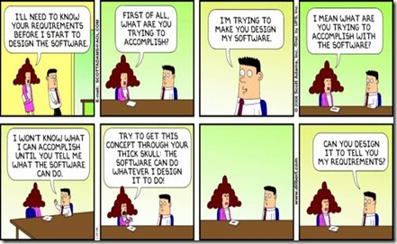
Scope Creep – Unknown unknowns
ECU Copyright 2015 – CSG 2344 School of Computer and Security Science

Slide 37
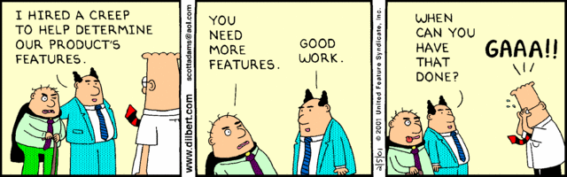
Aspects of Scope Creep
ECU Copyright 2015 – CSG 2344 School of Computer and Security Science

Slide 38

Scope Creep
Just remember that anything additional will affect your time, or someone else’s time, and there is almost always an additional cost. Scope creep often sounds like an addition that is going to be wonderful – but the change should never prevent you from completing the original project scope.
ECU Copyright 2015 – CSG 2344 School of Computer and Security Science

Slide 39
Suggestions for Reducing Incomplete and Changing Requirements
Develop and follow a requirements management process.
Use techniques such as prototyping, use case modeling, to get more user involvement.
Put requirements in writing and keep them current.
Allocate resources specifically for handling change requests and enhancements.
ECU Copyright 2015 – CSG 2344 School of Computer and Security Science

Slide 40
Suggestions for Improving User Input
Develop a good project selection process and insist that sponsors are from the user organization.
Place users on the project team in important roles.
Hold regular meetings with defined agendas, and have users sign off on key deliverables presented at meetings.
Deliver something to users/sponsors on a regular basis.
Don’t promise to deliver when you know you can’t.
Co-locate users with developers.
ECU Copyright 2015 – CSG 2344 School of Computer and Security Science

Slide 41

Summary
Project Integration Planning
Project Scope Planning
  Scope planning
  Scope definition
  WBS creation
  Scope control / Scope creep
  Change Control
ECU Copyright 2015 – CSG 2344 School of Computer and Security Science

